Slide 1

New Donor Acquisition Analysis
2022
Ramzi Deek

Slide 2
Presentation Overview
Business Background
Analysis Scope
Challenge Statement and Estimated Impact (descriptive)
In-depth Insights (predictive)
Case Studies and Actions (prescriptive)

Slide 3




Business Background
3 key KPIs
Non-profit
Revenue
Average Gift (revenue/gift #)
Revenue per donor
KPI
Gift #
Active Donor #
Frequency
(gift # per donor)

Slide 4
Analysis Scope

Slide 5




Donor Analysis
Donors are essential to the success of the programs.
We inspect and analyze donors from multiple dimensions.

Slide 6
Multi-dimensional Donor Analysis
1
By recurrence
New Donor
Existing Donors
2nd year
Key Multiyear
Reactivated 2nd Year
Lapsed Donors
13-24 Mo. Lapsed
25+ Mo. Lapsed

Slide 7

Multi-dimensional Donor Analysis
2
By gift channel
Offline only
Offline w Email
Online Only
Multichannel
1
By recurrence
New Donor
Existing Donors
2nd year
Key Multiyear
Reactivated 2nd Year
Lapsed Donors
13-24 Mo. Lapsed
25+ Mo. Lapsed

Slide 8

Multi-dimensional Donor Analysis
2
By gift channel
Offline only
Offline w Email
Online Only
Multichannel
1
By recurrence
New Donor
Existing Donors
2nd year
Key Multiyear
Reactivated 2nd Year
Lapsed Donors
13-24 Mo. Lapsed
25+ Mo. Lapsed
3
By contribution
Mid-level ($1K-$2.5K HAC)
Major (>=$2.5K HAC)
Broadbase (<$1K HAC)
Non-Donor

Slide 9
Challenge Statement

Slide 10
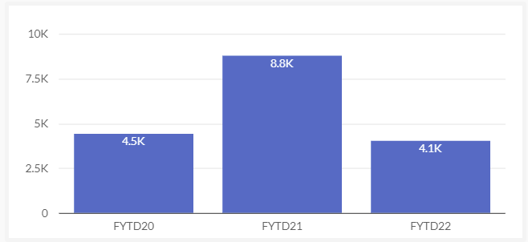
Challenge Statement
The most recent period (fiscal year to date 2022) is seeing a decrease in new donor acquisition.
New donor #
New donor number in 2022 drop by
4763
54%
Compared to the same period last year (2021).
* time period compared among the years are July - April
Unless specified, all year-to-year comparisons in this presentation is YTD.

Slide 11
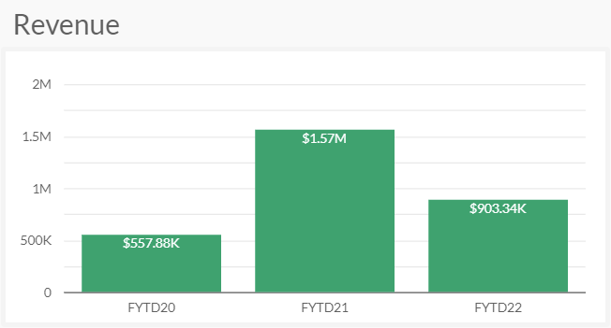
Impact from New Donor Drop
In 2021, new donors contributed a total of:
$1.98M
which is
30%
of the entire year revenue ($6.54M).
New donor number drop has caused a decrease of revenue in 2022 from new donor section by:
$ 668k (43%)
Compared to the same period* last year (2021).
New donor contribution is
16%
of the 2022 YTD revenue.
(new donors only)
New donors play an important role in revenue generation.
A reduction in new donors number in 2022 has caused a significant impact to the YTD revenue.
* time period compared among the years are July - April
Notes:
11.5% of the 2022 YTD revenue:
revenue drop from new donors (668k) / YTD overall revenue (5.8M) = 11.5%

Slide 12

Impact Prediction:
Full Fiscal Year and Next Year
2022 YTD new donor revenue gap (10 months):
$ 668k
2022 full fiscal year new donor revenue gap (12 months):
~$800k
2023 revenue loss due to 2022 new donor decline:
~$640k
The reduction of the new donor acquisition in the current year will keep on influencing the following years.
* see appendix for calculation
Notes:
$800k is calculated by dividing $668k by 10 months, and multiply by 12 months.

Slide 13
In-depth Insights
When did this trend begin?
What channels and subchannels are decreasing?
Why is this segment down?

Slide 14
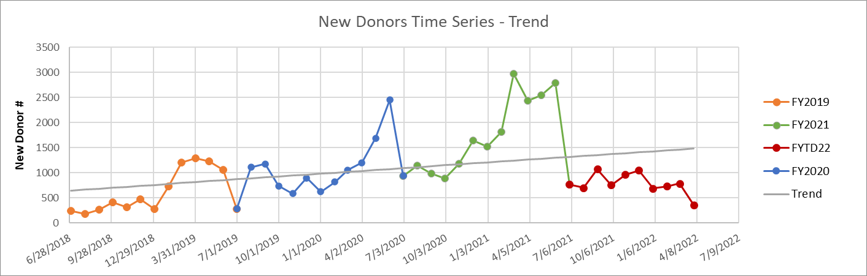
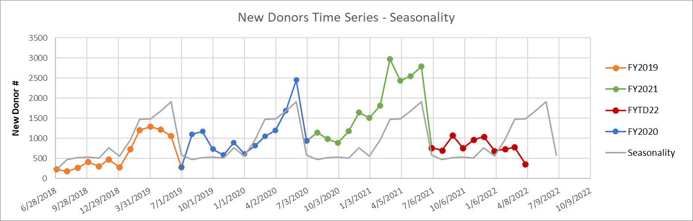
New Donors by Time - Trend and Seasonality
Trend
Seasonality

Slide 15
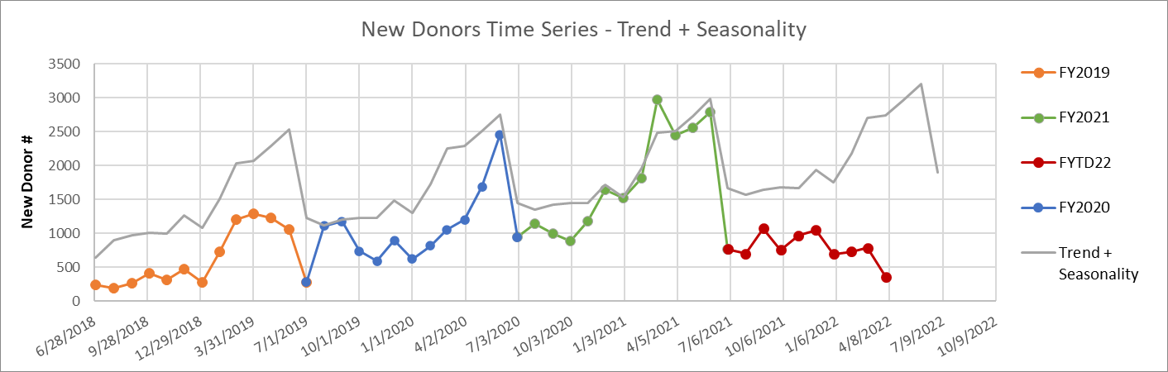
New Donors by Time - Predicted vs. Reality
The discrepancy between the predicted and reality seem to begin on 7/1/2021.
Notes:
Luckily this is also our fiscal year break point, which makes following analysis much easier.

Slide 16
Gift Channels and Subchannels
Acquisition
Acquisition - Direct Mail Acquisition - Digital Acquisition - Telemarketing unknown
Monthly Giving
Caring Partners Caring Partner Check Writers
Internet Giving
Digital Appeals & Newsletters eBooks & Petitions unknown
General
General Unrestricted General General Restricted
Direct Response
Direct Mail Acknowledgements
Escrow
Escrow Direct Response Escrow Acquisition Direct Mail Acknowledgements Escrow Acquisition
Telemarketing
Telemarketing
Gifts can be acquired through 7 channels, and numerous subchannels.

Slide 17
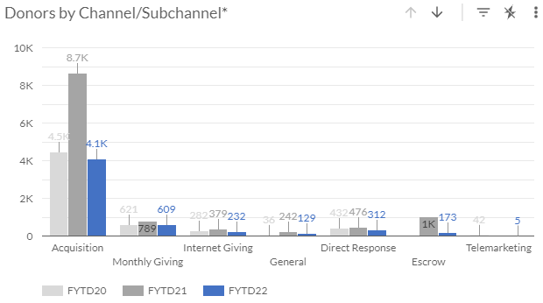
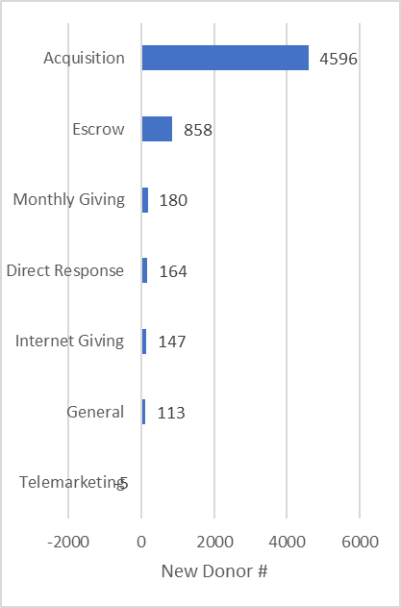
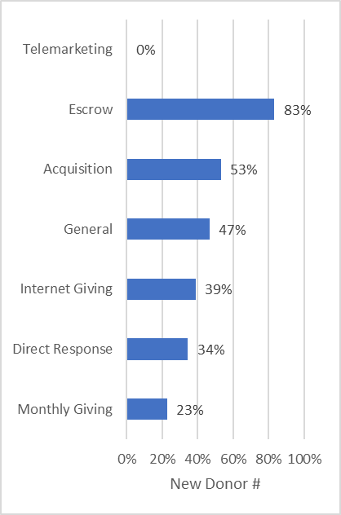
New Donors by Channel - Dropping
Top dropping channel by new donor #:
Top dropping channel by %:
New donor # has decreased in most of the channels from 2021 to 2022 fiscal year.
Acquisition channel and Escrow channel are the most significantly dropped channels.
Them combined contribute to 90% of new donor decline.
Notes:
Ranking of drops by percentage

Slide 18
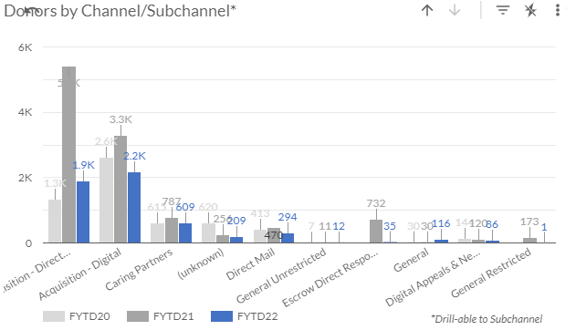
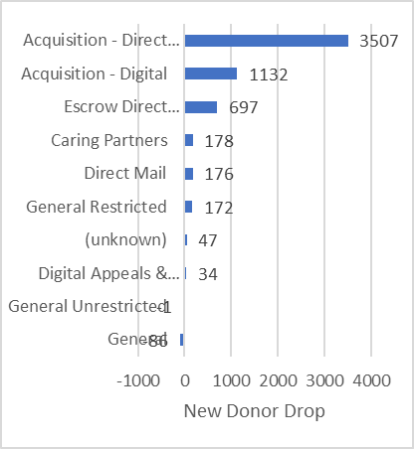
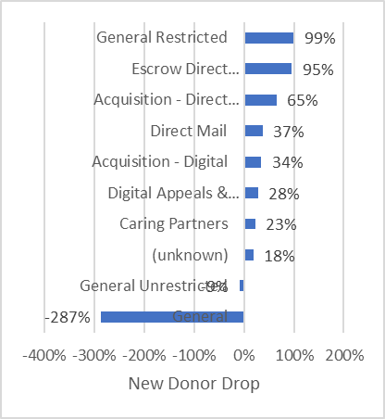
New Donors by Subchannel - Dropping
Top dropping channel by new donor #:
Top dropping channel by %:
A decrease in most of the subchannels from 2021 to 2022 fiscal year is also observed.
Acquisition - Direct Mail, Acquisition - Digital, and Escrow Direct Response are top 3 subchannels that dropped significantly.
Them combined contribute to 91% of new donor decline.

Slide 19
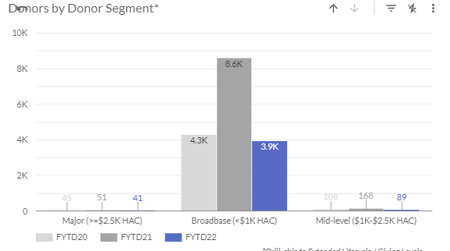
Donors by Contribution
The newly acquired donors are mostly Broadbase (<$1k HAC).

Slide 20
Campaign Effectiveness
New Donor #
New Donor Revenue
Campaigns | FYTD20 | FYTD21 | FYTD22
BEQUEST | 1 | 1
FATHERHOOD |  |  | 1
QBEQUEST | 2 | 1
QCT |  | 22 | 19
QGeneral |  | 83
QGRANT | 2
QPDL |  | 1
Grand Total | 5 | 108 | 20
Campaigns | FYTD20 | FYTD21 | FYTD22
BEQUEST | $7,936 | $36,000
FATHERHOOD |  |  | $10,000
QBEQUEST | $40,555 | $17,500.00
QCT |  | $196,215.00 | $136,881
QGeneral |  | $433,379.00
QGRANT | $12,000
QPDL |  | $15,000
Grand Total | $60,491 | $698,094 | $146,881
Restarting the QGeneral campaign might not increase the number of new donors significantly, but should increase revenue contribution by new donors greatly.

Slide 21
Case Studies and Proposed Actions
Improve web channels to acquire more new donors.

Slide 22
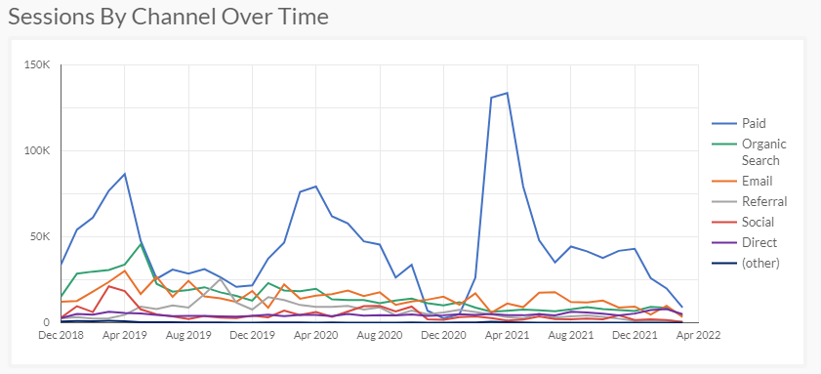
Case Study: Webpage Sessions
Motivation: Acquisition - Digital channel contributes significantly to the new donor # decline in 2022.
February and March are the critical points
The most significant change was in paid channel.
March usually spikes except 2022.

Slide 23
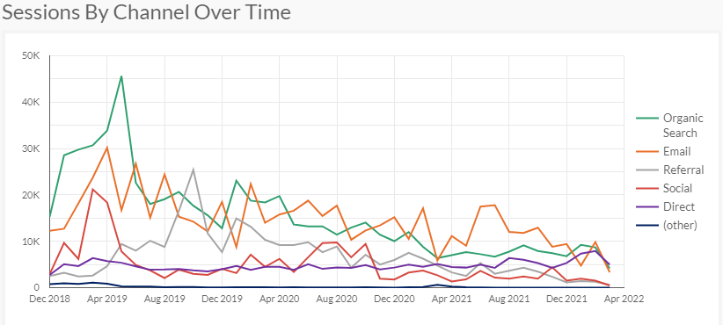
Case Study: Webpage Sessions
(all channels other than paid)
All other channels show a downward trend throughout the years.

Slide 24
Insights and Actions
Still need to prove the correlation between web page sessions and new donor acquisition.
Assuming there is a correlation between web page sessions and new donor acquisition:
Less web page visits might mean less new donor acquired.
Possible causes of web session visits decline:
Non-controllable (politics, economy)
return from the pandemic
Inflation
Rise of Prices
All lead to less
Controllable
Investment in paid channels
The campaign strategy is getting out of date

Slide 25
Conclusions:
The most recent period (fiscal year to date 2022) is seeing a decrease in new donor acquisition.
This decrease is expected to have multi-year negative impact to revenue
The decrease is estimated to start ~7/1/2021
The decrease is most significantly shown in Acquisition and Escrow channels
QGeneral campaign can help bring up revenue from new donors significantly
Web traffic is studied to explain the new donor acquisition decline
More investment or an improved campaign strategy should be considered to improve web page traffic

Slide 26
Thank you for your attention!
Questions?

Slide 27
Appendix

Slide 28
Impact Prediction Calculation
Revenue generated from new donors in 2020: $787,094.00
Revenue generated from 2nd year donors in 2021: $679,623
New donor retention: 679623/787094 = 86.3% (full year)
Revenue generated from new donors in 2021: $1,571,221.00
Revenue generated from 2nd year donors in 2022: $1,195,679
New donor retention: 1195679/1571221 = 76.1% (YTD)
Average of 86.3% and 76.1% = 81.2% ~80%
800k (estimated 2022 new donor gap) * 80% = 640k

Slide 29
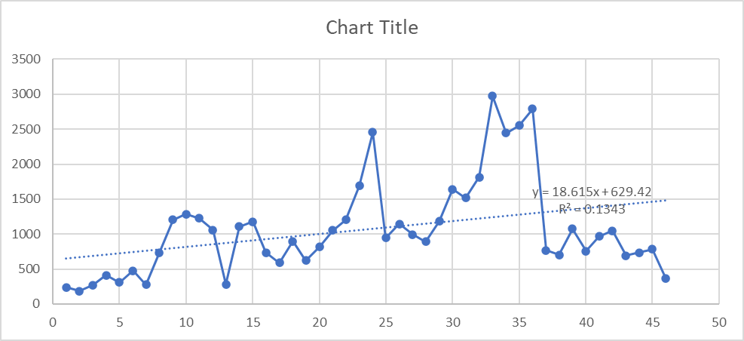
New Donor Acquisition Trend
Calculation performed in Microsoft Excel

Slide 30
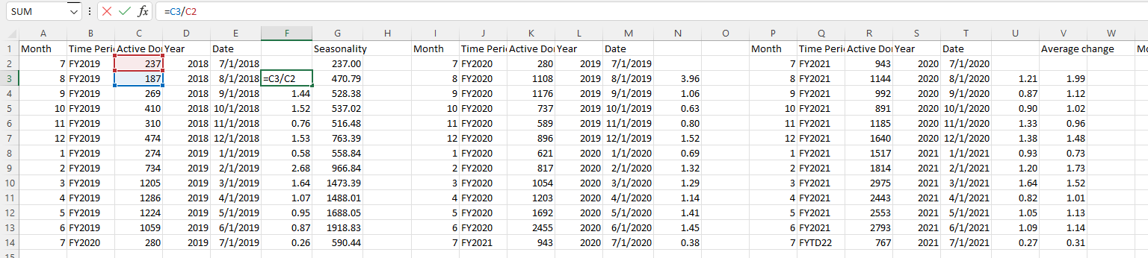
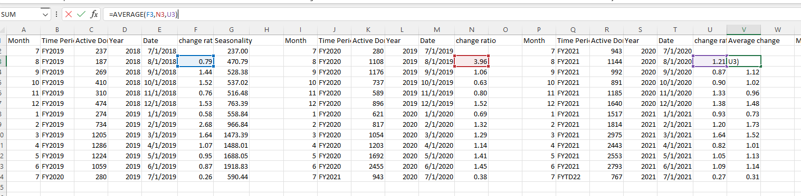
New Donor Acquisition Seasonality
Calculation performed in Microsoft Excel

Slide 31
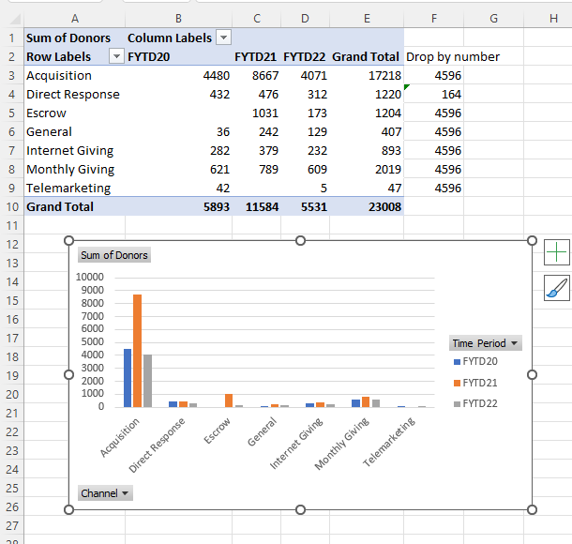
Channel Drop Calculation using Excel pivot table

